Slide 1
FREEBIES FOR NEWBIES
A place to find free event and items
Team Members:
Manoj Kumar Gude
Harish Chowdary Bala
Aditya Krishna Raavi
Jaichand Mulakalapalli
Saibabu Devarapalli
Client & Mentor:
Dr. Chandra Mouli Kotteti

Slide 2
Team Members
JAICHAND MULAKALAPALLI
(TEAM LEADER) BACKEND
MANOJ KUMAR GUDE
FRONTEND
ADITHYA KRISHNA RAAVI
FRONTEND
Saibabu devarapalli
Fullstack
HARISH CHOWDARY BALA
DATABASE
DR. CHANDRA MOULI KOTTETI
Mentor & Client

Slide 3
Table of Contents
Scroll View In Android
Action Bar (Navigation Bar)
Back4App Database
RecylerViews
Lessons Learned
Summary
Date Picker and Time Picker
Introduction

Slide 4




Introduction
Freebies for Newbies is an android application, which helps international students to access to free items and events in the desired location.
Tools and Design:
Android Studio - The tool used for the UI development.
GenyMotion - Emulator (Virtual device).
Git Hub - To integrate UI part and store it.
Oracle VirtualBox - Its an essential tool required to run for GenyMotion.
Back4App - Database.
Programming Language:
Java

Slide 5
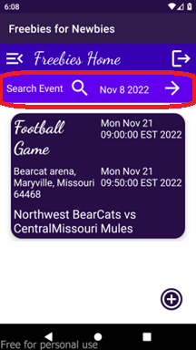
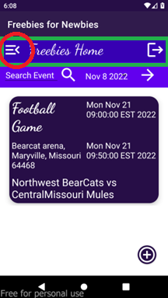
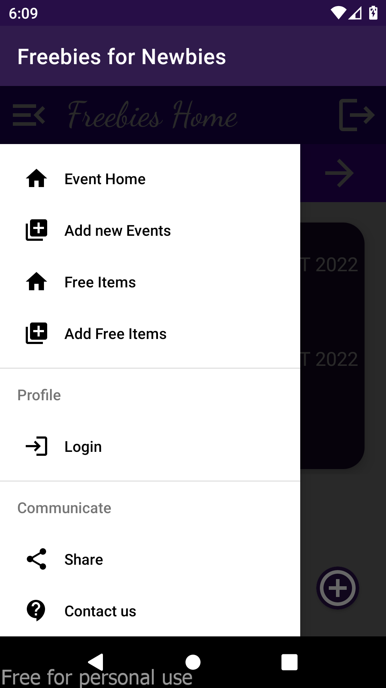
Action Bar (Navigation Bar)
An Action Bar is a place to display navigational controls, Controls to support switching from one view to another using menu options.
Fig. 1: Search toolbar and Navigation bar with different controls like menu options, home, logout etc.,

Slide 6
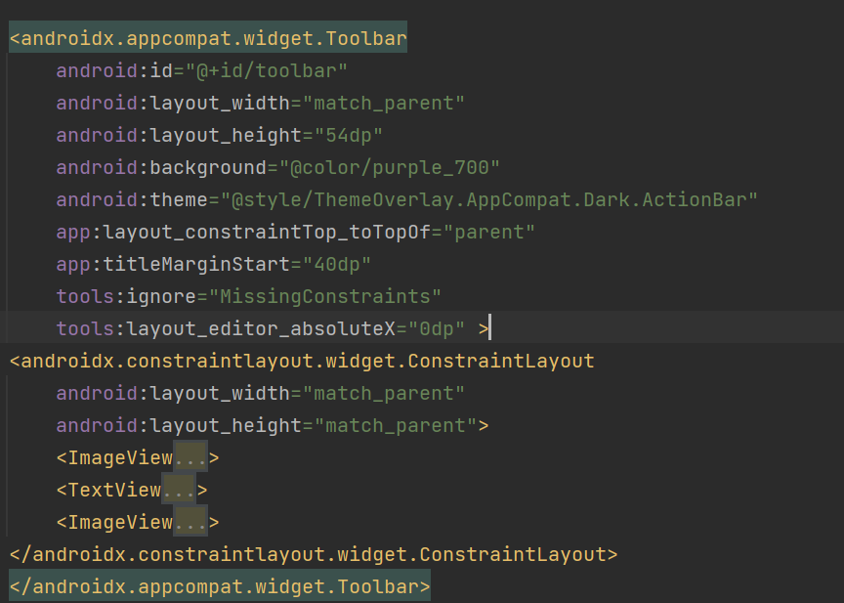
Action Bar (Navigation Bar)
Fig. 2: Navigation bar XML code

Slide 7
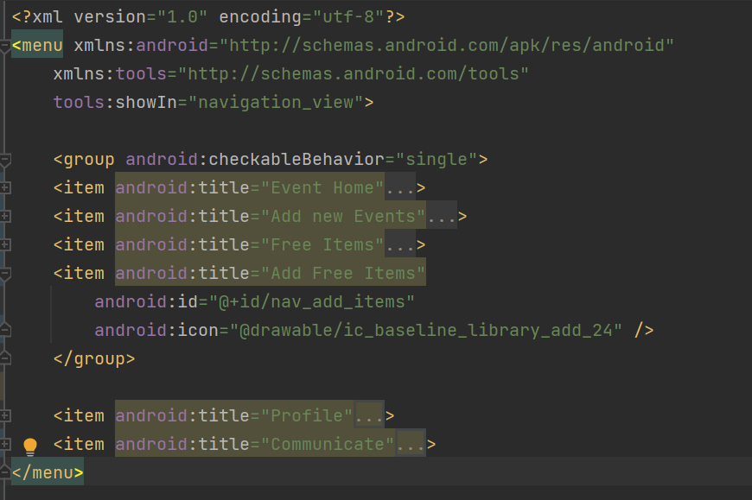
Action Bar (Navigation Bar)
Fig. 3: Menu items XML code

